Slide 1
Optical Fiber Communication

Slide 2
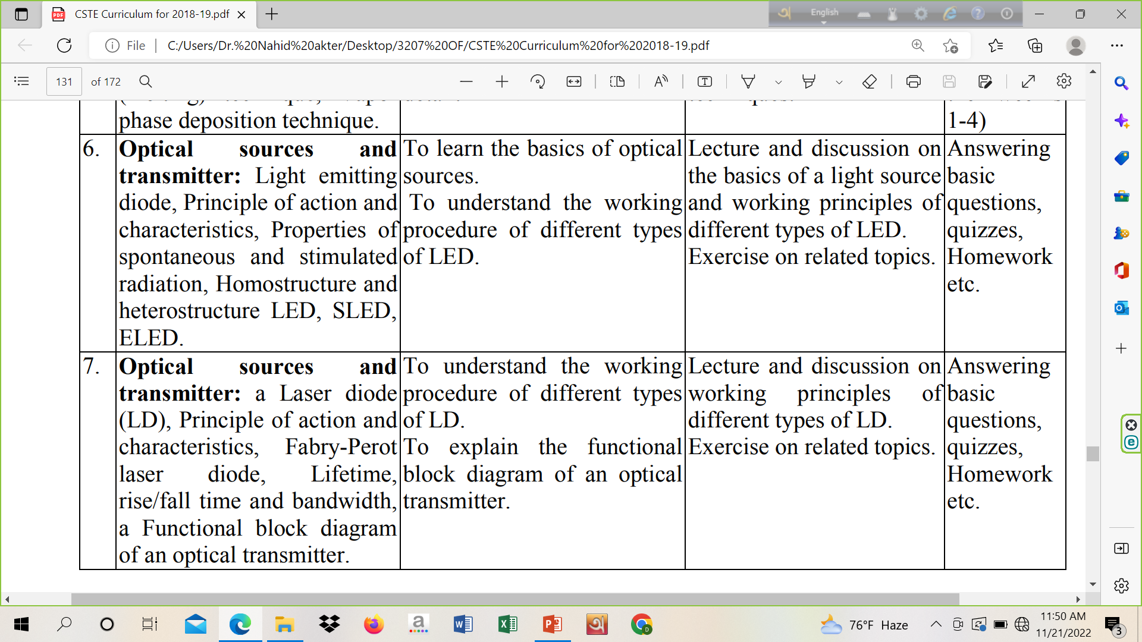

Slide 3
Optical Sources

Slide 4
Light Emitting Diode
A light-emitting diode (LED) is a semiconductor device that emits light when an electric current flows through it. When current passes through an LED, the electrons recombine with holes emitting light in the process. LEDs allow the current to flow in the forward direction and blocks the current in the reverse direction.
The light emitting diode is a p-n junction diode. It is a specially doped diode and made up of a special type of semiconductors.

Slide 5
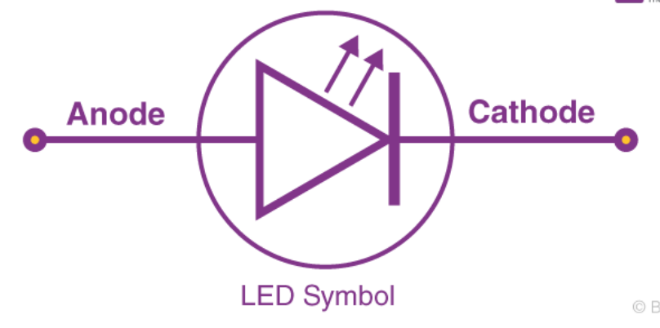
Symbol

Slide 6
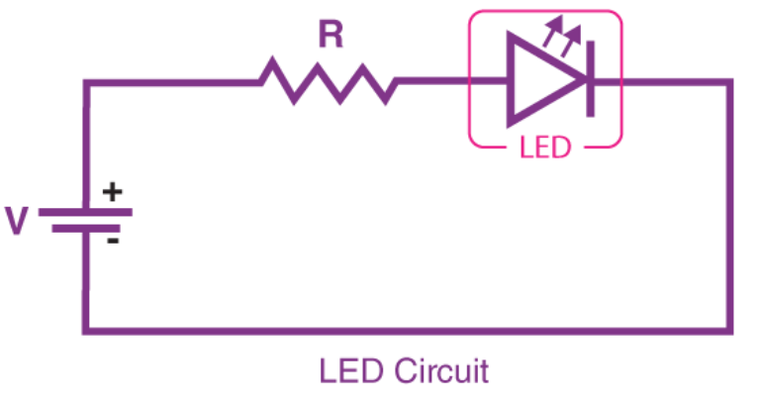
Simple LED Circuit

Slide 7
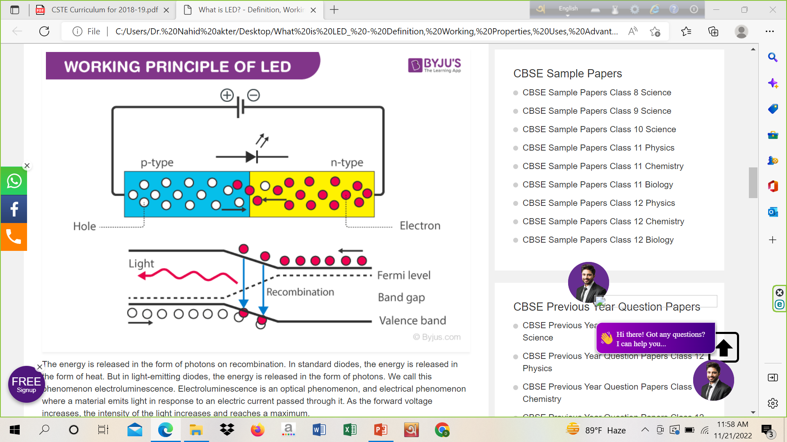
How does LED work?

Slide 8
How does LED work?
The light-emitting diode simply, we know as a diode. When the diode is forward biased, then the electrons & holes are moving fast across the junction and they are combined constantly, removing one another out. The recombination indicates that the electrons in the conduction band jump down to the valence band. When the electrons jump from one band to another band the electrons will emit the electromagnetic energy in the form of photons and the photon energy is equal to the forbidden energy gap.

Slide 9
How does LED work?
Simple working steps:
The power supply across the p-n junction makes the diode forward biased and pushing the electrons from n-type to p-type. Pushing the holes in the opposite direction.
Electron and holes at the junction are combined.
The photons are generated as the electrons and holes are recombined.

Slide 10
How does LED work?
The working principle of the Light-emitting diode is based on the quantum theory. The quantum theory says that when the electron comes down from the higher energy level to the lower energy level then, the energy emits in the form of photon. The photon energy is equal to the energy gap between these two energy levels.
For example, let us consider the quantum theory, the energy of the photon is the product of both the Planck constant and frequency of electromagnetic radiation. The mathematical equation is shown
Eg = hf
Where h is known as a Planck constant, and the velocity of electromagnetic radiation is equal to the speed of light (c ). The frequency of radiation is related to the velocity of light as an
f= c / λ.
λ is denoted as a wavelength of electromagnetic radiation and the above equation will become as a
Eg = hc / λ

Slide 11
How does LED work?
From the above equation, we can say that the wavelength of electromagnetic radiation is inversely proportional to the forbidden gap. In general silicon, germanium semiconductors this forbidden energy gap is between the conduction and valence bands are such that the total radiation of electromagnetic wave during recombination is in the form of infrared radiation. We can’t see the wavelength of infrared because they are out of our visible range.
The infrared radiation is said to be as heat because the silicon and the germanium semiconductors are not direct bandgap semiconductors rather these are indirect gap semiconductors. In the indirect bandgap semiconductors, the maximum energy level of the valence band and minimum energy level of the conduction band does not occur at the same moment of electrons. Therefore, during the recombination of electrons and holes are migration of electrons from the conduction band to the valence band the momentum of the electron band will be changed.

Slide 12
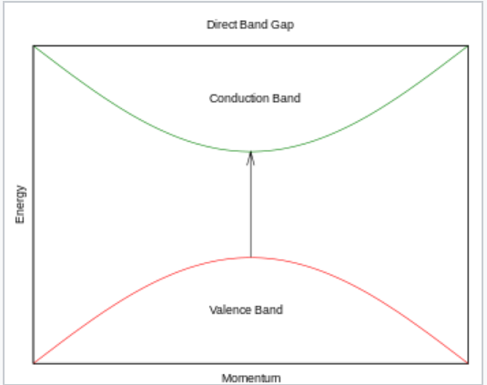
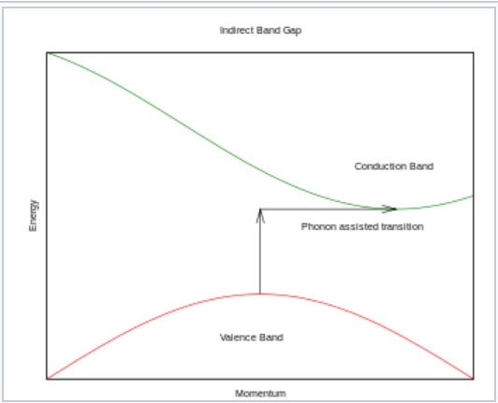
Energy-Momentum Graph
Direct and Indirect Bandgap Semiconductor
(a) GaAs (b) Silicon

Slide 13
LED circuit for biasing
Most of the LEDs have voltage ratings from 1 volt-3 volt whereas forward current ratings range from 20 mA-100 mA.
If the voltage (1V to 3V) is applied to the LED, then it functions properly due to the flow of current for the applied voltage will be in the operating range. Similarly, if the applied voltage to an LED is high than the operating voltage then the depletion region within the light-emitting diode will break down due to the high flow of current. This unexpected high flow of current will damage the device.
This can be avoided by connecting a resistor in series with the voltage source & an LED. So this resistor plays a key role in protecting the LED. The safe voltage ratings of LEDs will be ranges from 1V to 3 V whereas safe current ratings range from 20 mA to 100 mA.

Slide 14
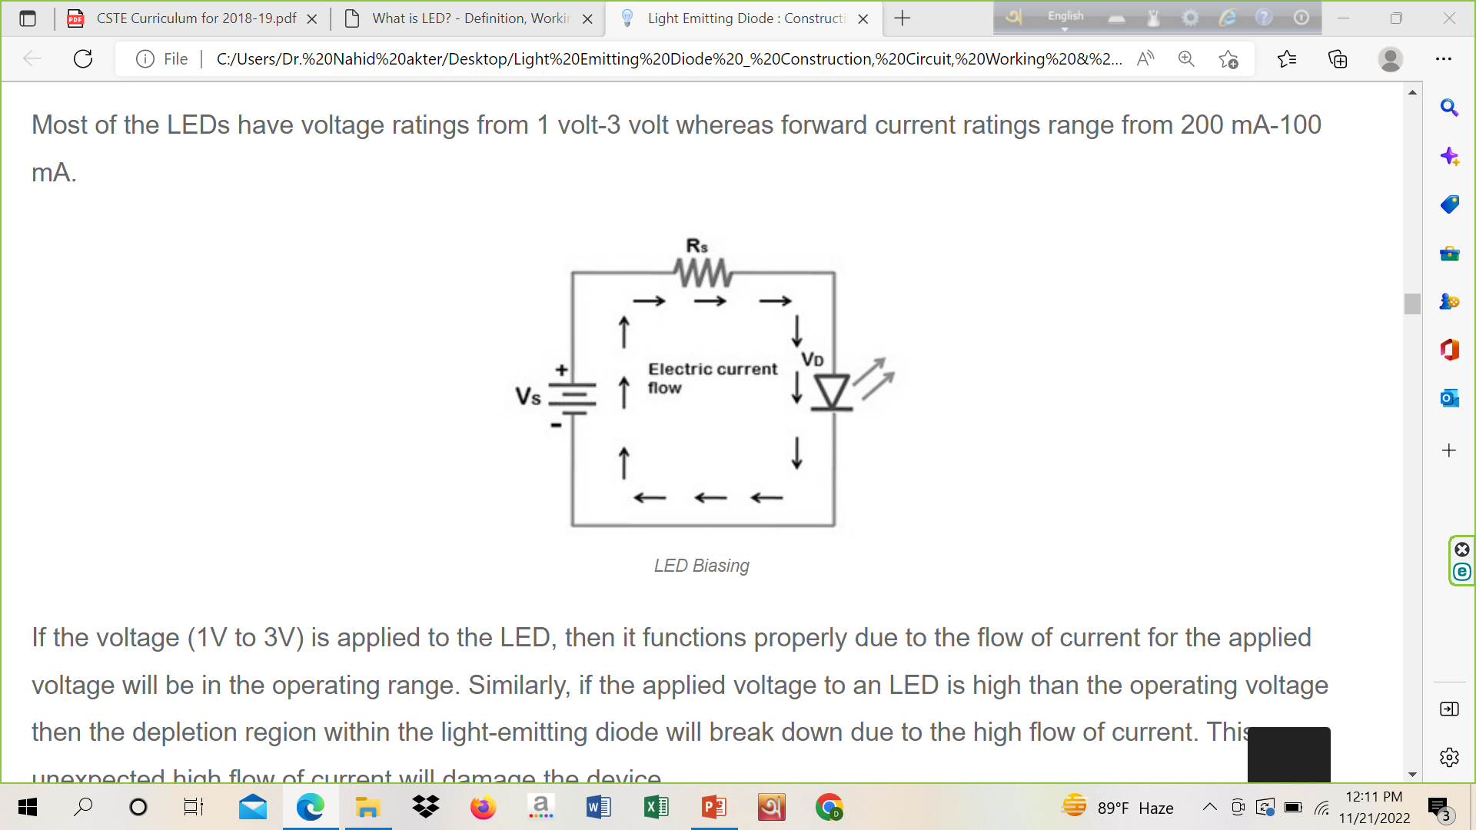
LED circuit for biasing

Slide 15
LED circuit for biasing
Mathematically, the flow of current through the LED can be written as
IF = (Vs – VD)/Rs
Where ‘IF ‘is forward current, ‘Vs’ is a voltage source, ‘VD’ is the voltage drop across the light-emitting diode, ‘Rs’ is a current limiting resistor

Slide 16
Types (wrt Color)
Gallium Arsenide (GaAs) – infra-red
Gallium Arsenide Phosphide (GaAsP) – red to infra-red, orange
Aluminium Gallium Arsenide Phosphide (AlGaAsP) – high-brightness red, orange-red, orange, and yellow
Gallium Phosphide (GaP) – red, yellow and green
Aluminium Gallium Phosphide (AlGaP) – green
Gallium Nitride (GaN) – green, emerald green
Gallium Indium Nitride (GaInN) – near-ultraviolet, bluish-green and blue
Silicon Carbide (SiC) – blue as a substrate
Zinc Selenide (ZnSe) – blue
Aluminium Gallium Nitride (AlGaN) – ultraviolet

Slide 17
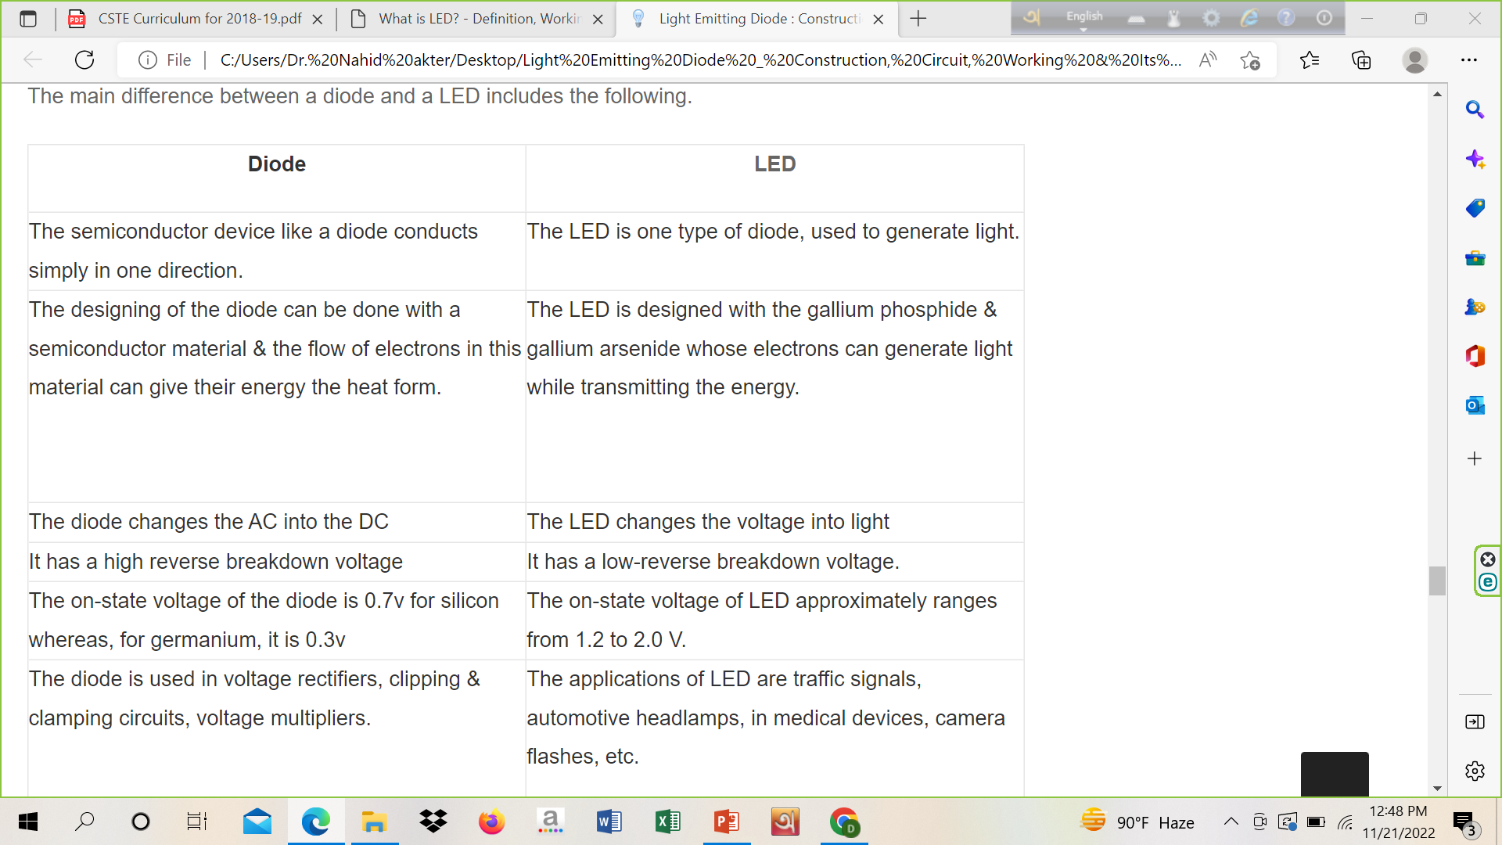
Difference between Diode and LED

Slide 18
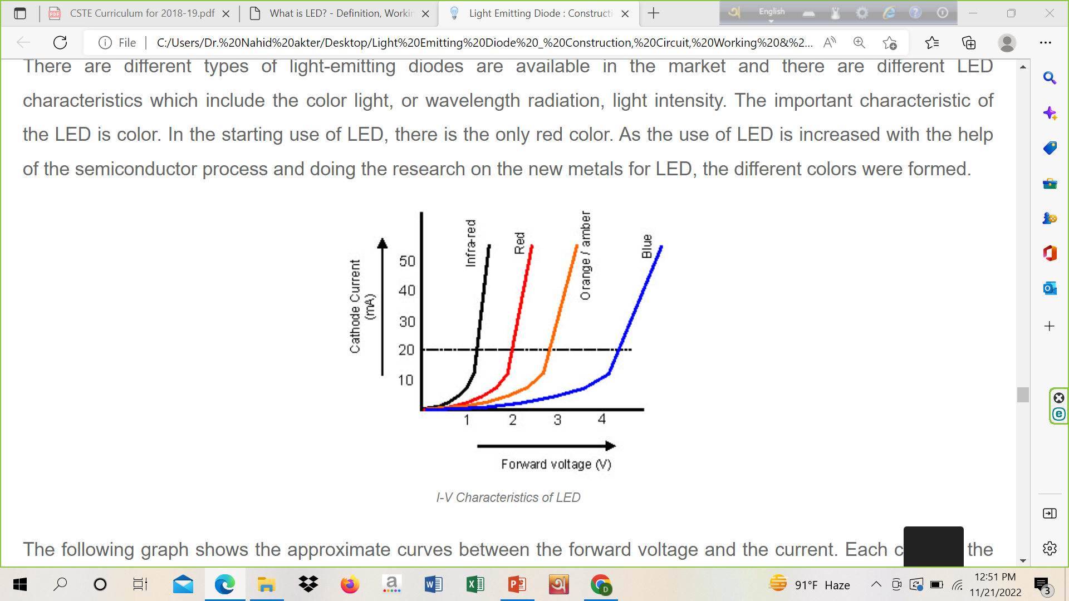
I-V Characteristics of LED

Slide 19
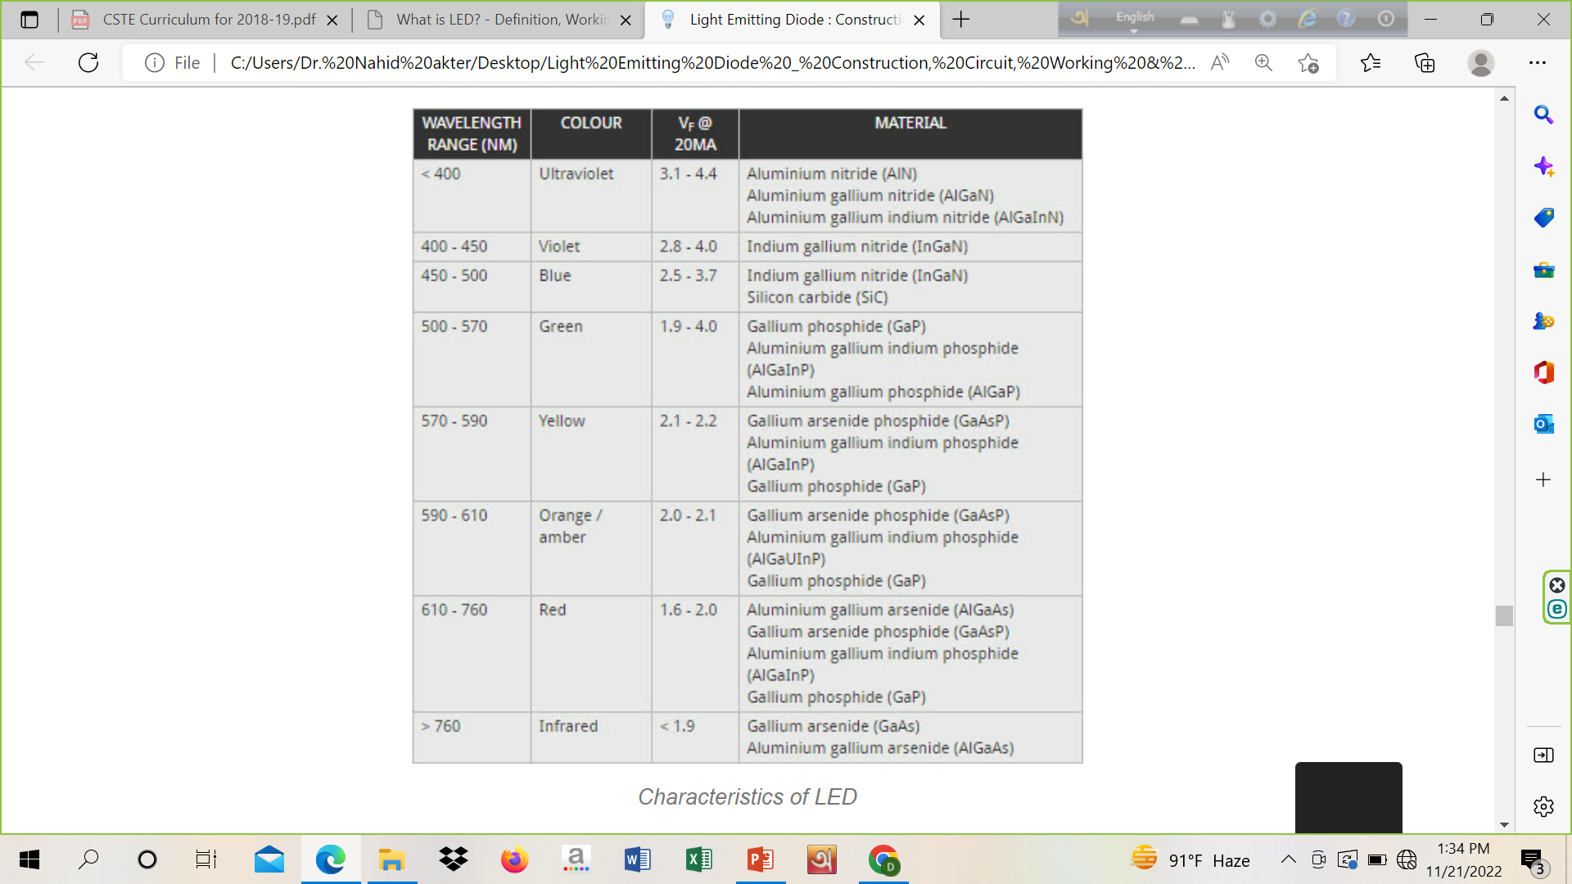
LED Characteristics Summary

Slide 20
Advantages
The cost of LED’s is less and they are tiny.
By using the LED’s electricity is controlled.
The intensity of the LED differs with the help of the microcontroller.
Long Lifetime
Energy efficient
No warm-up period
Rugged
Doesn’t affect by cold temperatures
Directional
Color Rendering is Excellent
Environmentally friendly
Controllable

Slide 21
Disadvantages
Temperature sensitivity
Temperature dependence
Light quality
Electrical polarity
Voltage sensitivity
Efficiency drop
Impact on insects

Slide 22
Application
LED is used as a bulb in the homes and industries
The light-emitting diodes are used in motorcycles and cars
These are used in mobile phones to display the message
At the traffic light signals LED’s are used

